Slide 1
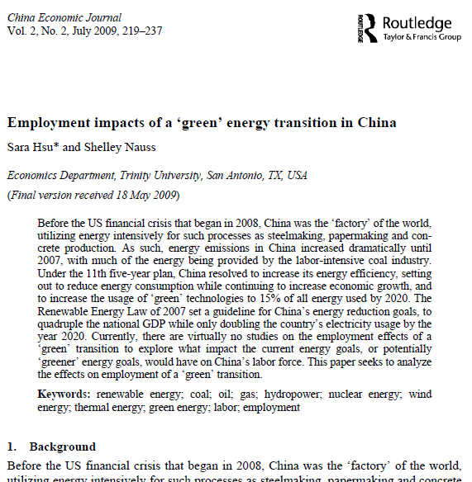
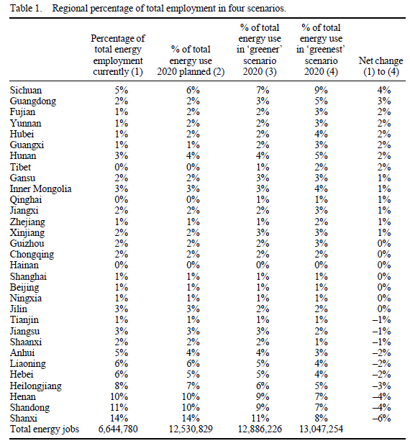
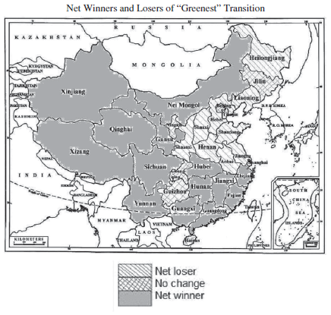
Case Study Three: Employment Change From Green Transition
Sara Hsu & Shelley Nauss (2009) Employment impacts of a ‘green’ energy
transition in China, China Economic Journal, 2:2, 219-237, DOI: 10.1080/17538960903083533
Objectives: To predict change in employments due to China’s transition into greener energy sources
Data Sources
China Data Online
China Industrial Yearbook
Data
Mean and Coefficient of Variation Within Regional/Sectoral Employment
Regional Energy Employment
Energy Production (1995-2006)
Energy Production Distribution According to Four Scenarios
Multiple energy employment data for each energy sectors

Slide 2
Case Study Three: Employment Change From Green Transition
Methodology
From the distribution of jobs and energy production each energy from historical data, the distribution of jobs in 2020 under the 11th year plan is calculated. Then, from ‘greener’ and ‘greenest’ scenarios, the effects of a hypothetical energy industry transformation on job creation and destruction is estimated.
Flowchart
Data Inputs
Data Analysis
Outputs
Data Extraction from CDI and CIY
Mean Distribution of Employment
Distribution of Employment in Four Scenarios
Tables
Bar Chart
China ESRI ShapeFile
Regional Energy Employment
Map

Slide 3
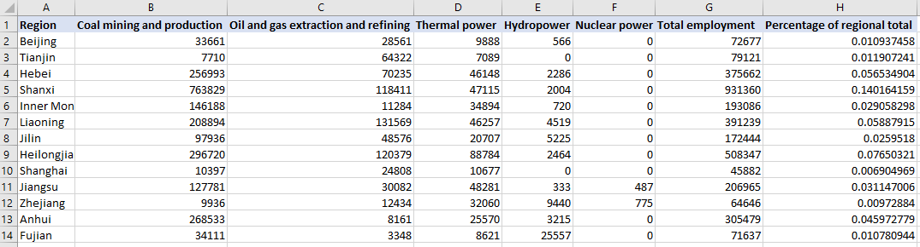
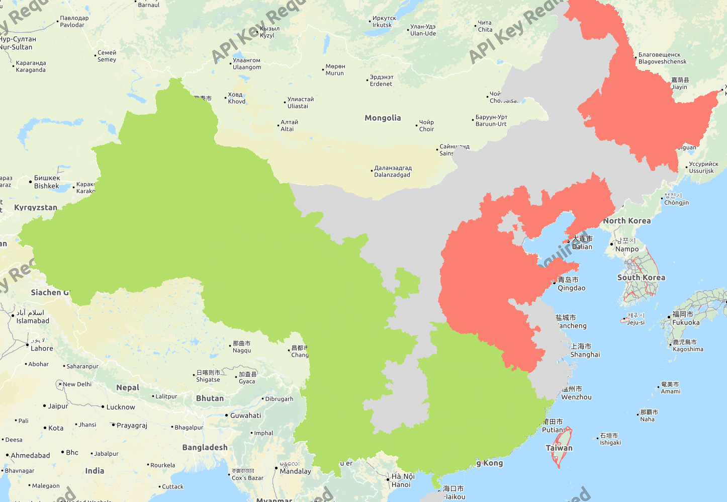
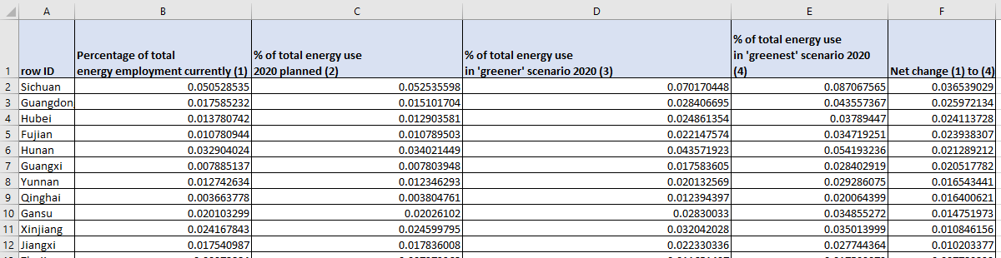
Case Study Three: Employment Change From Green Transition
Outputs from the Workflow
Mean Per Regional/Sectoral Employment (1999-2007)
Net Winners and Losers of “Greenest” Transition
Red: Provinces with a significant employment distribution loss
Gray: Provinces with small or no change in employment distribution
Green: Provinces with a significant employment distribution gain
Regional percentage of total employment in four scenarios

Slide 4
Online Demonstration

Slide 5
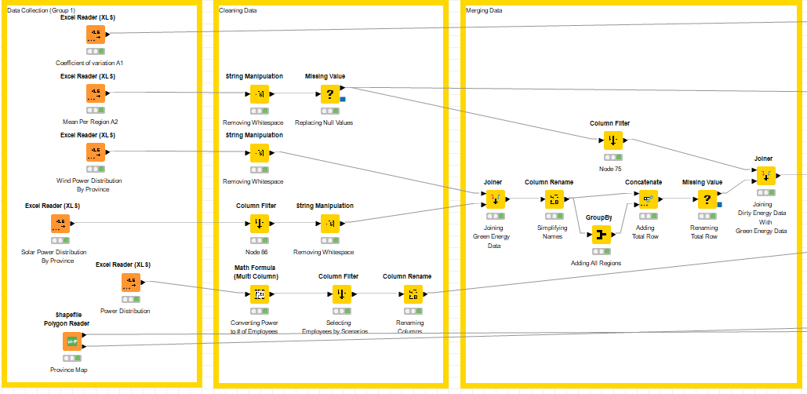
Case Study Three: Employment Change From Green Transition

Slide 6
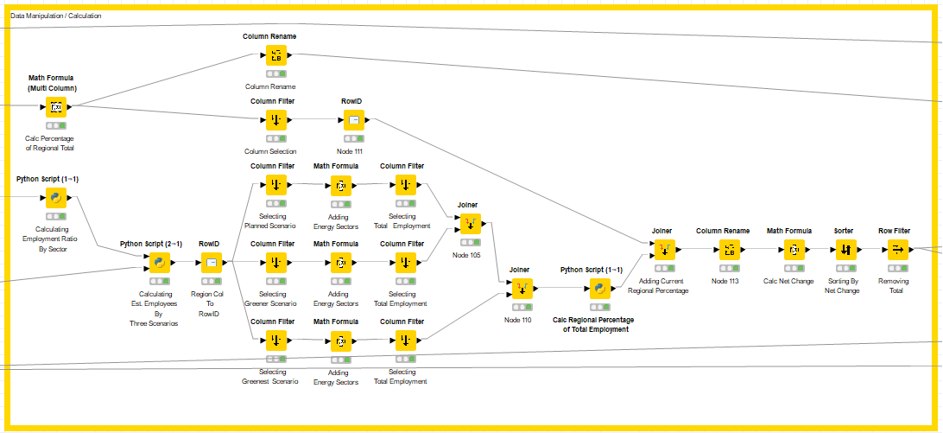
Case Study Three: Employment Change From Green Transition

Slide 7
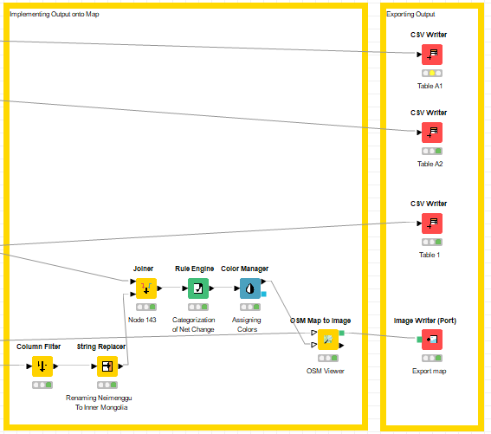
Case Study Three: Employment Change From Green Transition

Slide 8
Case Study Three: Employment Change From Green Transition
Steps for Running the Workflow
Step 1: Download data and unzip from https://drive.google.com/drive/folders/1OX-G2w6nSDVuVKEkrQ4EwZ5UhhNkmCLB?usp=sharing
Step 2: Download workflow from https://drive.google.com/drive/folders/1OX-G2w6nSDVuVKEkrQ4EwZ5UhhNkmCLB?usp=sharing
Step 3: Open KNIME from local PC or China Data Lab Cloud Platform (in building)
Step 4: Import KNIME workflow file (Employment Impacts of a Energy Transition.knwf)
Step 5: Configure “Input Data” for each table and figure
Step 6: Configure nodes in “exporting output” section on the local computer
Step 6: Click Run function from the top menu
Step 7: Display the outputs:
Coefficient of variation (A1).csv
Mean Employment (A2).csv
Regional percentage of total employment in four scenarios.csv
Employment Map.png
Regional energy employment (A3).csv
Regional Employment Bar Chart.png
Energy Production.csv

